Slide 1
Customer Churn Analysis

Slide 2
Key Insights derived from EDA

Slide 3
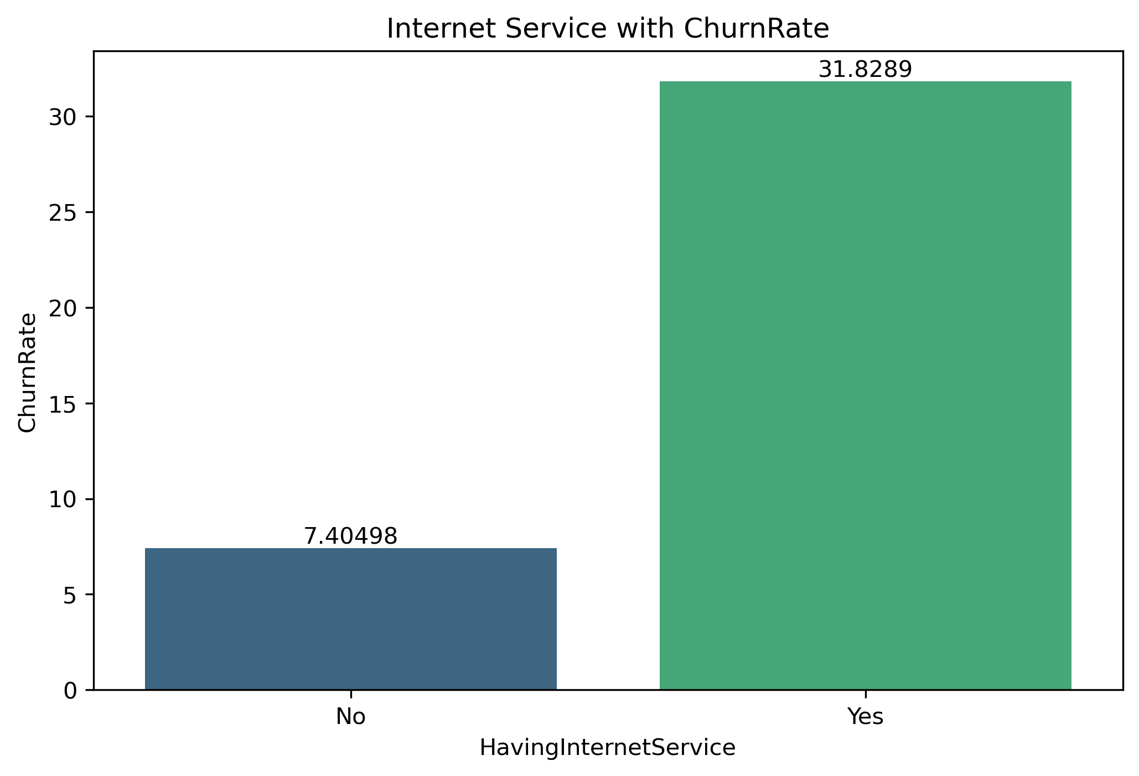
Impact of Internet Service on Customer Churn
Customers with Internet service have a higher churn rate (31.8%) compared to those without (7.4%).
Indicates potential issues with service quality, pricing, or customer satisfaction.
Improve Service Quality: Ensure stable, fast, and reliable internet connections.
Feedback Collection: Regularly gather feedback to identify pain points and act on them.

Slide 4
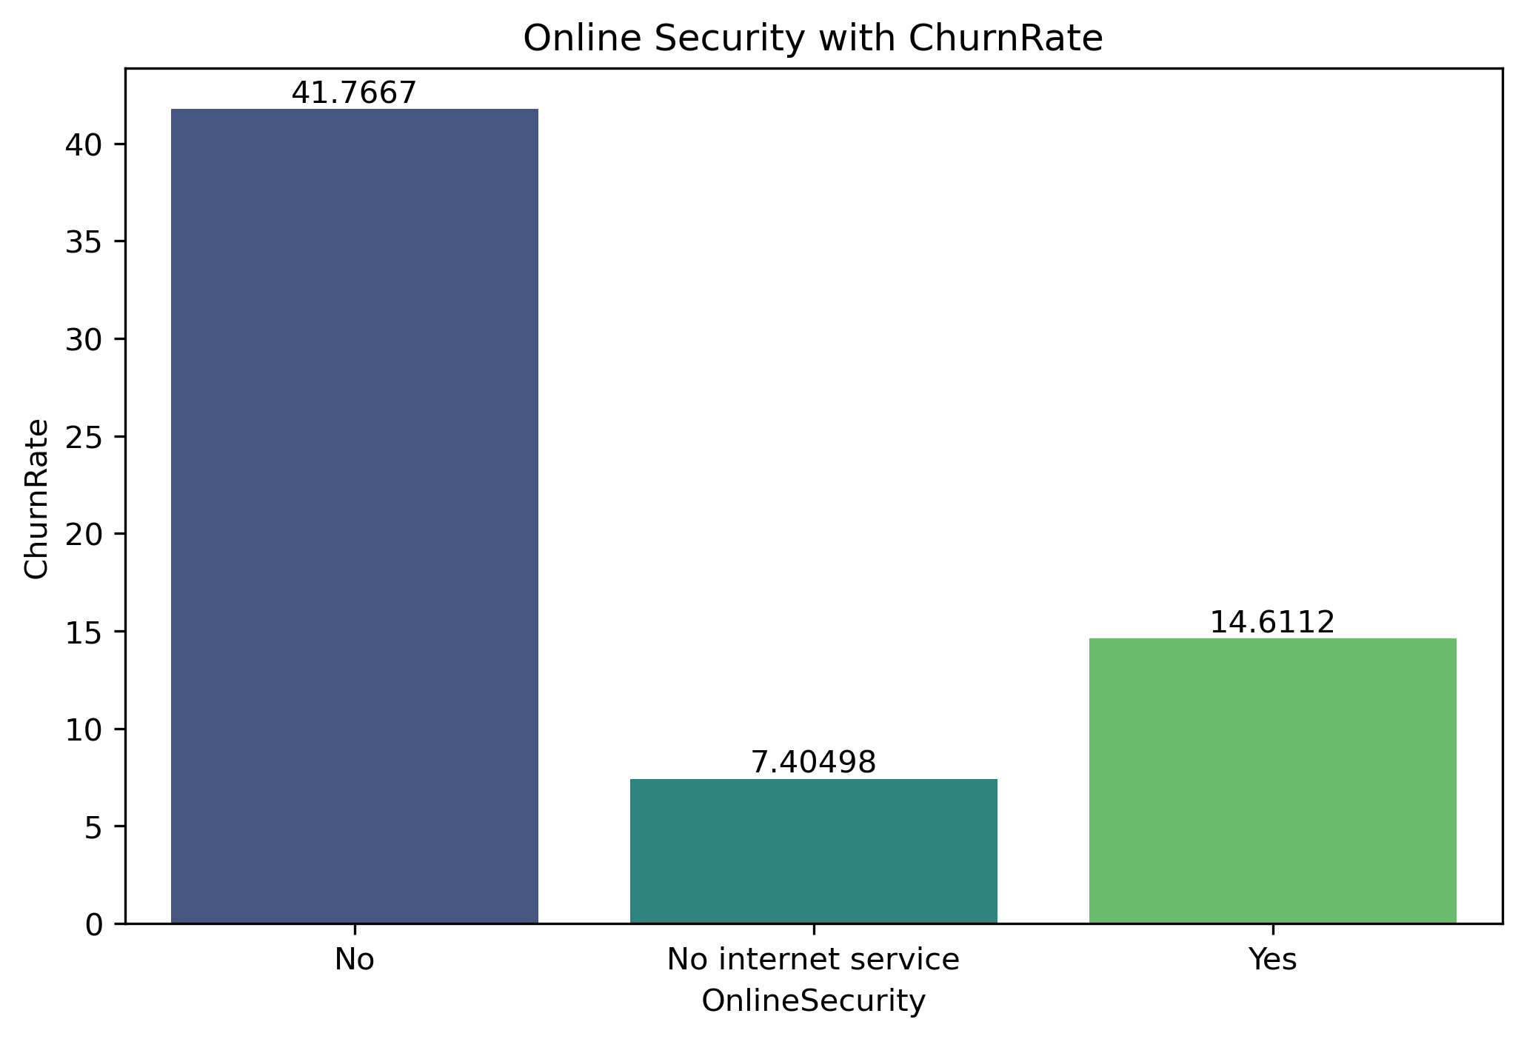
Impact of Online Security on Customer Churn
Customers without online security have the highest churn (41.7%), indicating they are the most at-risk segment.
Customers with online security show a much lower churn rate (14.6%), suggesting the service helps retain customers.
Customers marked as No Internet have a low churn rate (7.4%) because they intentionally do not use internet, so their churn is not related to online security and should not be blamed on the product.
Target customers without online security with awareness campaigns, bundled offers, and proactive retention strategies to lower their churn.
Handle the No Internet segment separately, since their churn is unrelated to Online Security usage.

Slide 5
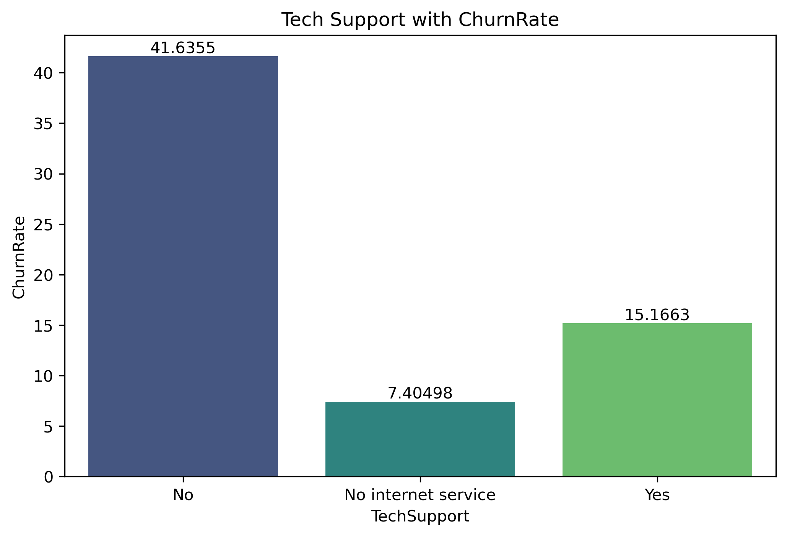
Impact of Tech Support on Customer Churn
Customers without tech support have the highest churn (41.6%), indicating they are the most at-risk segment.
Customers with tech support show a much lower churn rate (15.16%), suggesting the service helps retain customers.
Customers marked as No Internet have a low churn rate (7.4%) because they intentionally do not use internet, so their churn is not related to Tech support and should not be blamed on the product.
Target customers without tech support with awareness campaigns, bundled offers, and proactive retention strategies to lower their churn.
Handle the No Internet segment separately, since their churn is unrelated to Tech Support usage.

Slide 6
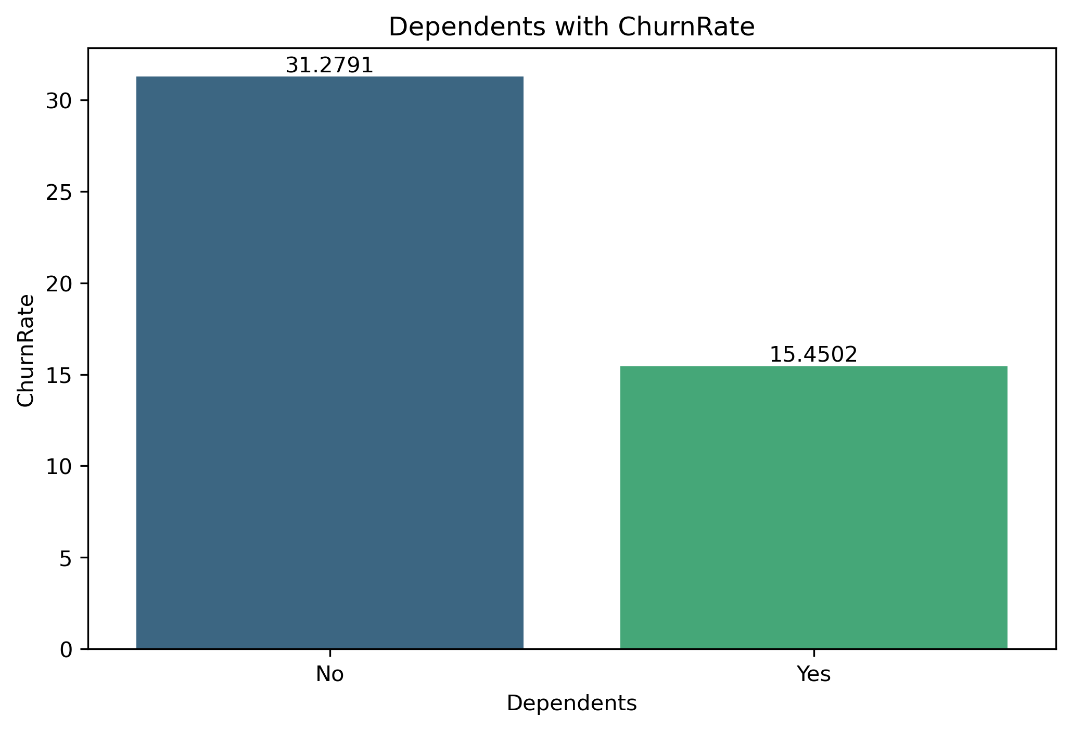
Impact of Dependents on Customer Churn
Customers with dependents have a lower churn rate (15.45%), suggesting they are more stable, more value-focused, and less likely to leave.
Customers without dependents show a much higher churn rate (31.27%), indicating they are more price-sensitive, quicker to switch, or less tied to long-term commitments.
Dependents appear to act as a retention factor, reducing the likelihood of churn.
Target customers without dependents with loyalty offers, discounts, and personalized retention campaigns, since they are the highest-risk group.
For customers with dependents, consider family-oriented bundles or add-ons to strengthen retention further.

Slide 7
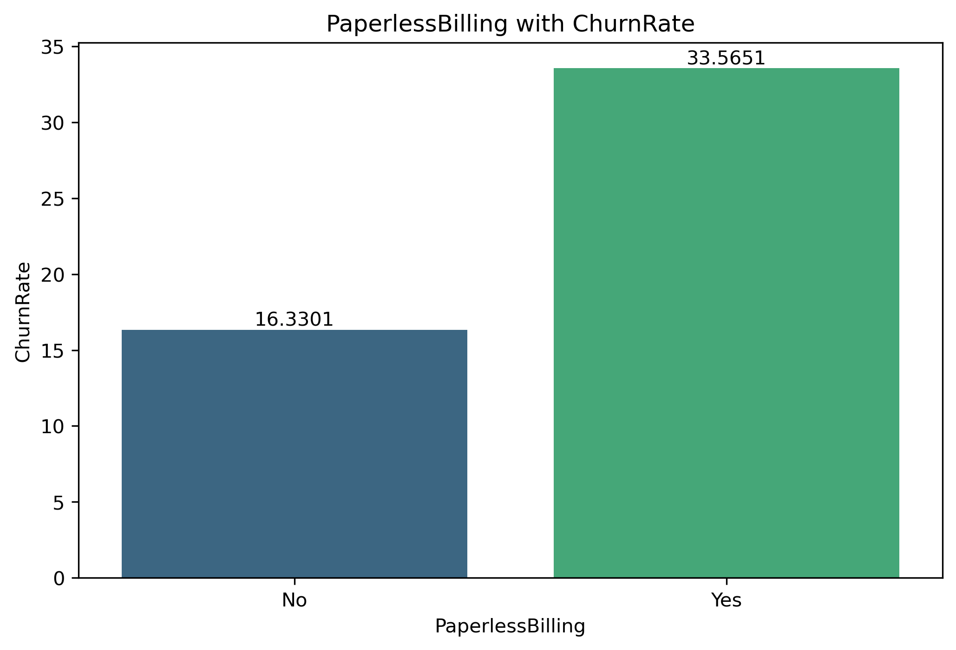
Impact of Paperless Billing on Customer Churn
Customers using paperless billing have a higher churn rate (33.56%), suggesting they may be more digitally active, more price-aware, and quicker to switch to competitors.
Customers not using paperless billing show a lower churn rate (16.33%), indicating they tend to be more traditional and more stable.
Paperless billing customers appear to be a higher-risk churn segment, not because of billing mode itself but due to their behavior patterns.
Focus retention efforts on paperless billing users through personalized offers, better digital engagement, and proactive communication.
Improve digital billing experience with clear statements, reminders, and value messaging to reduce dissatisfaction.

Slide 8
Key insights derived from SQL analysis

Slide 9
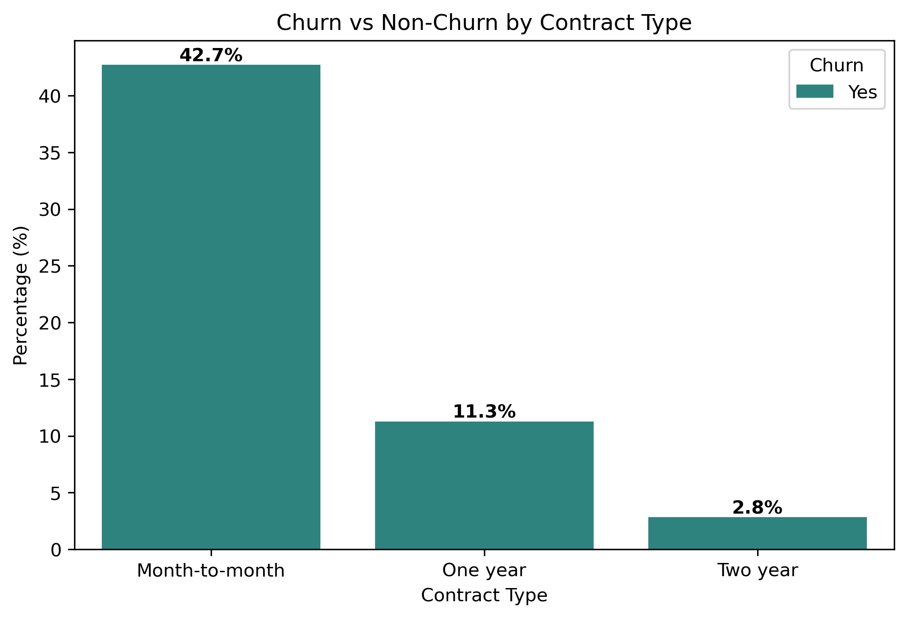
Longer Commitment improves customer retention
Customers having month-to-month contract type have churned more indicates that short term commitment increases the likelihood of customer cancellation whereas 1year and 2year contracts show much lower churn indicates that long term commitment improves customer retention.

Slide 10
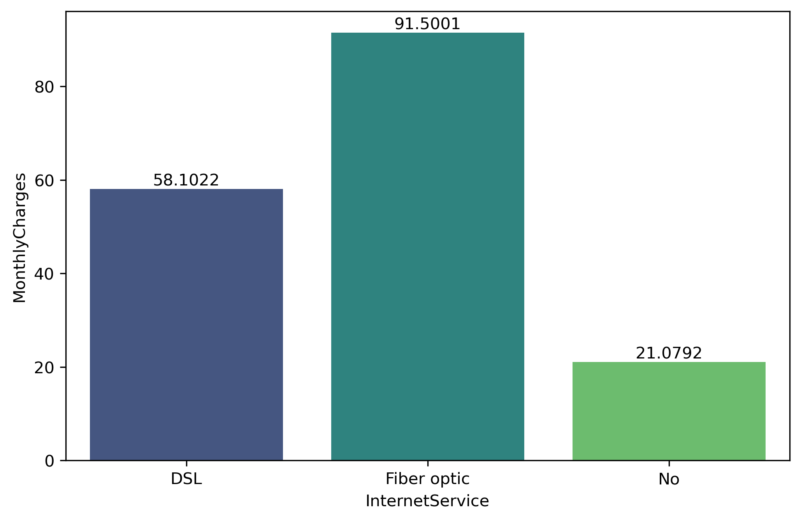
Fiber Optic Customers contribute more to revenue
Fiber optic customers have highest average monthly charges compared to DSL and No internet service customers.
This suggests that Fiber optic plans are premium offering, generating more revenue per customer.
Customer with no internet service contribute the least to monthly revenue.

Slide 11
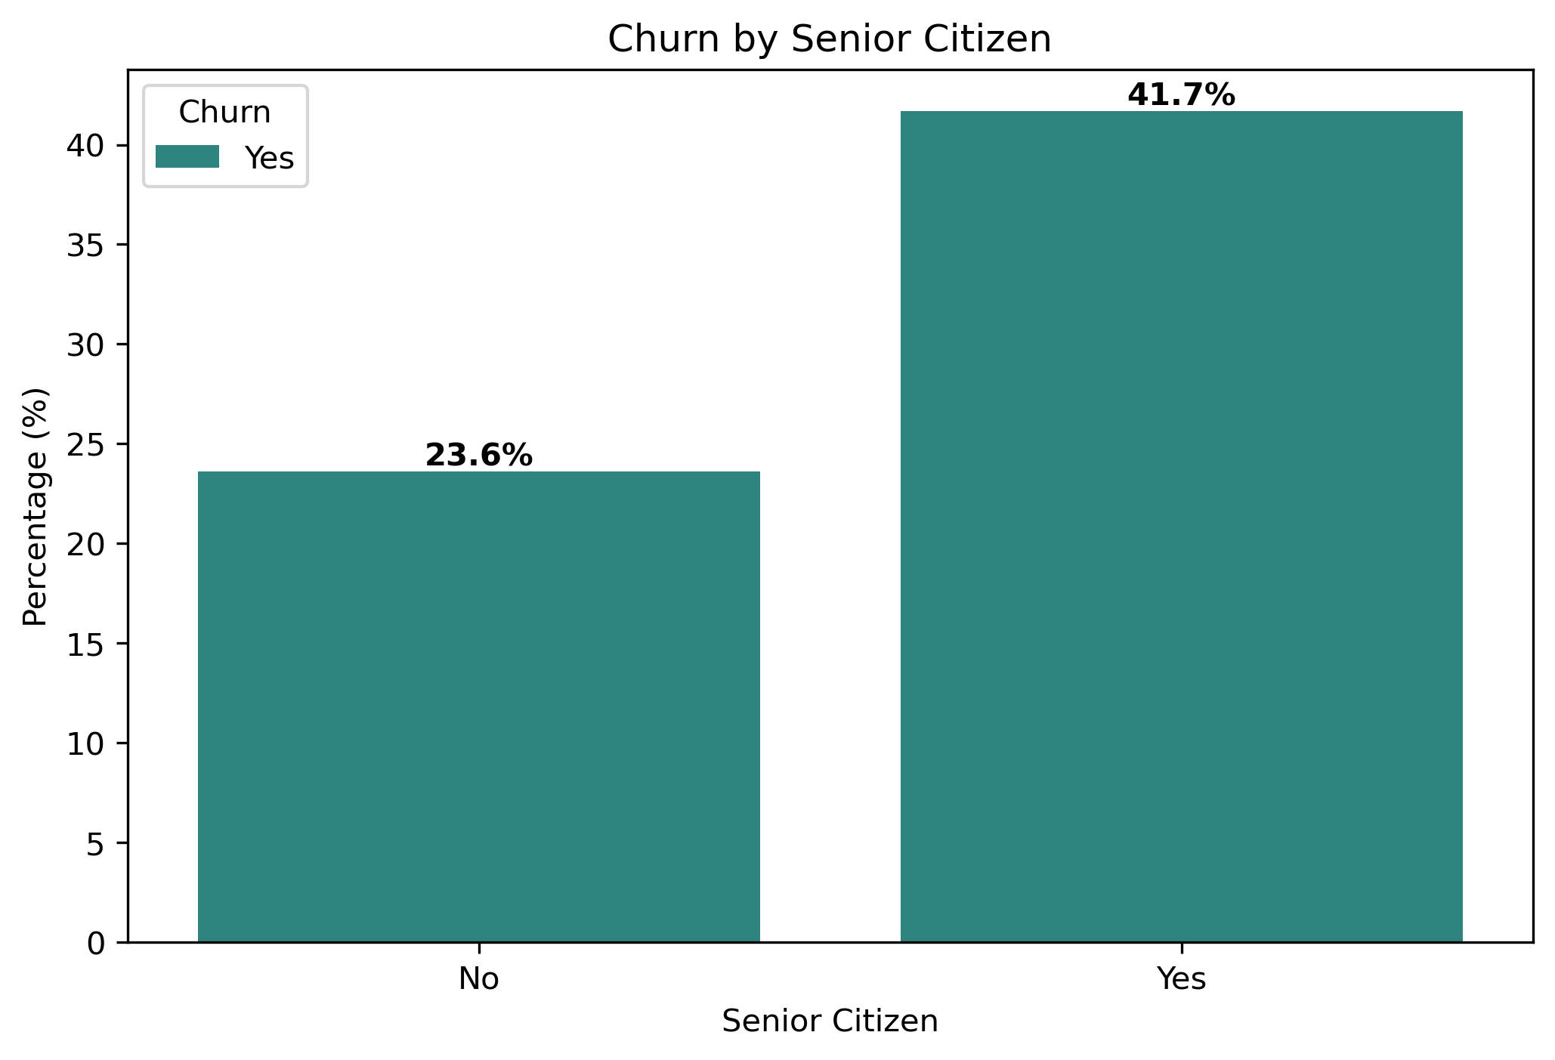
Older Customers more likely to Churn
Younger Customers are more likely to retain the service rather than older customers.
The churn rate among senior citizens is significantly higher(41.7%), indicating that this segment may require targeted retention strategies or improved customer support to reduce attrition.

Slide 12
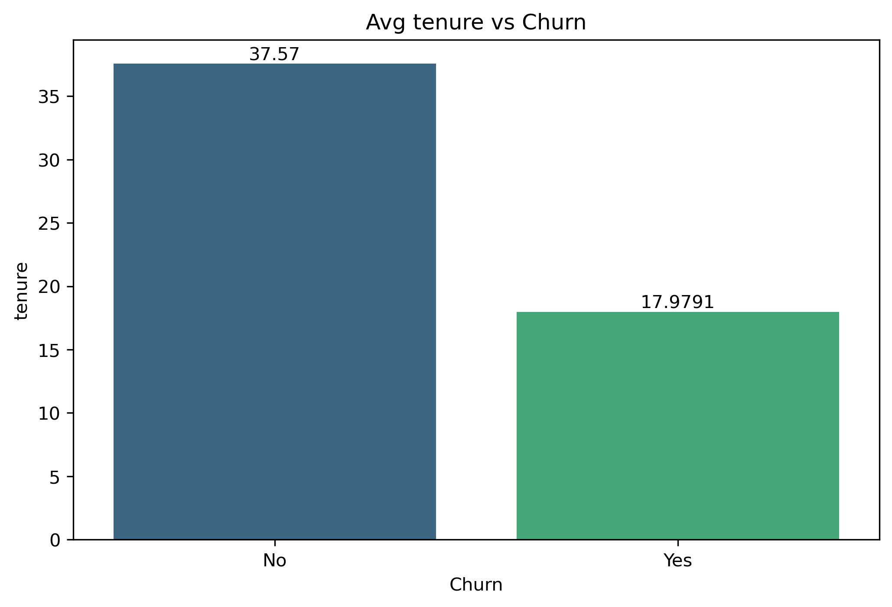
Churn Customers have lower avg tenure
Customers with shorter tenure(18) are more likely to churn, while long-term customers tend to stay loyal. This shows that the risk of churn is highest during the early stage of the customer relationship.
Provide early engagement offers or loyalty rewards within the first few months.
Proactively monitor new customers’ satisfaction using surveys or feedback systems.

Slide 13
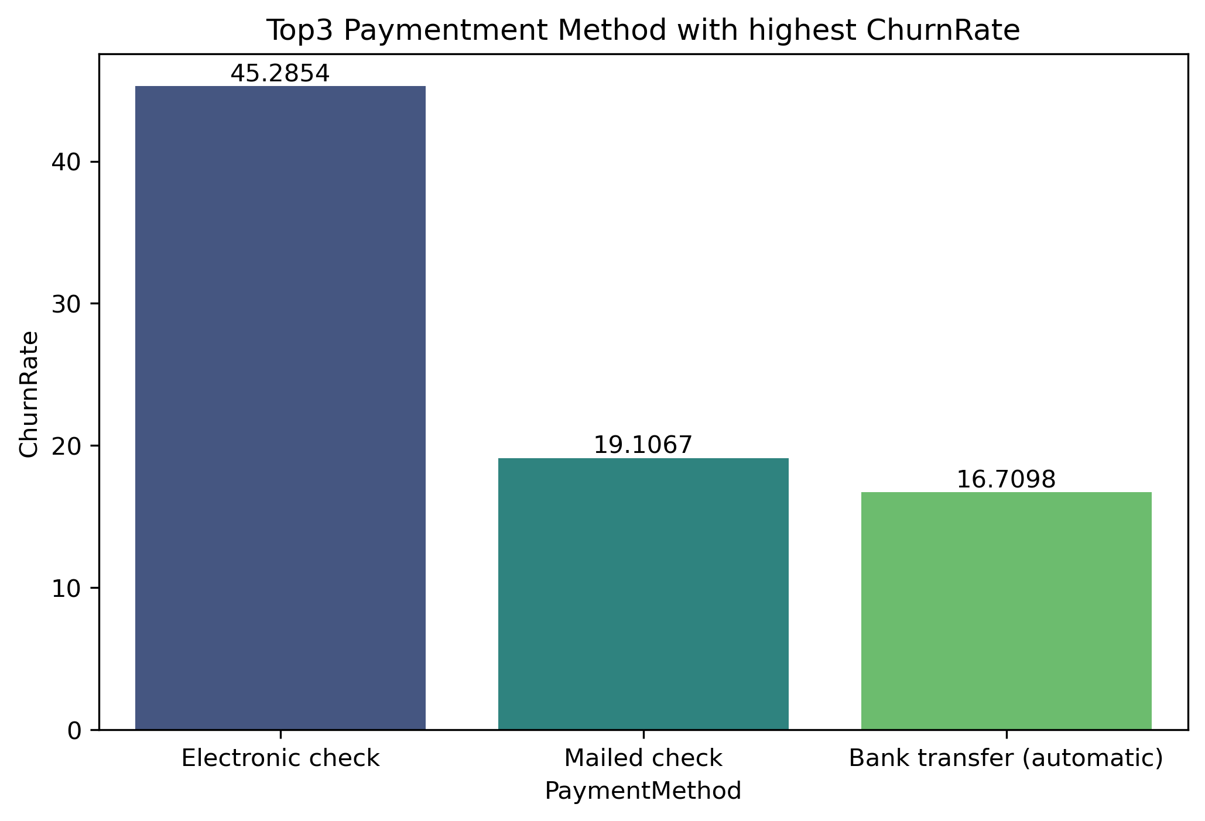
Top 3 payment method having highest Churn Rate
Customers using Electronic Check as their payment method show the highest churn rate (45.28%).
Since this payment type depends on internet access, it’s likely that connectivity or network issues may be contributing to higher churn among these users.
Investigate internet-related issues reported by customers using electronic check payments.
Promote offline or auto-debit payment options to reduce dependency on internet connectivity.

Slide 14
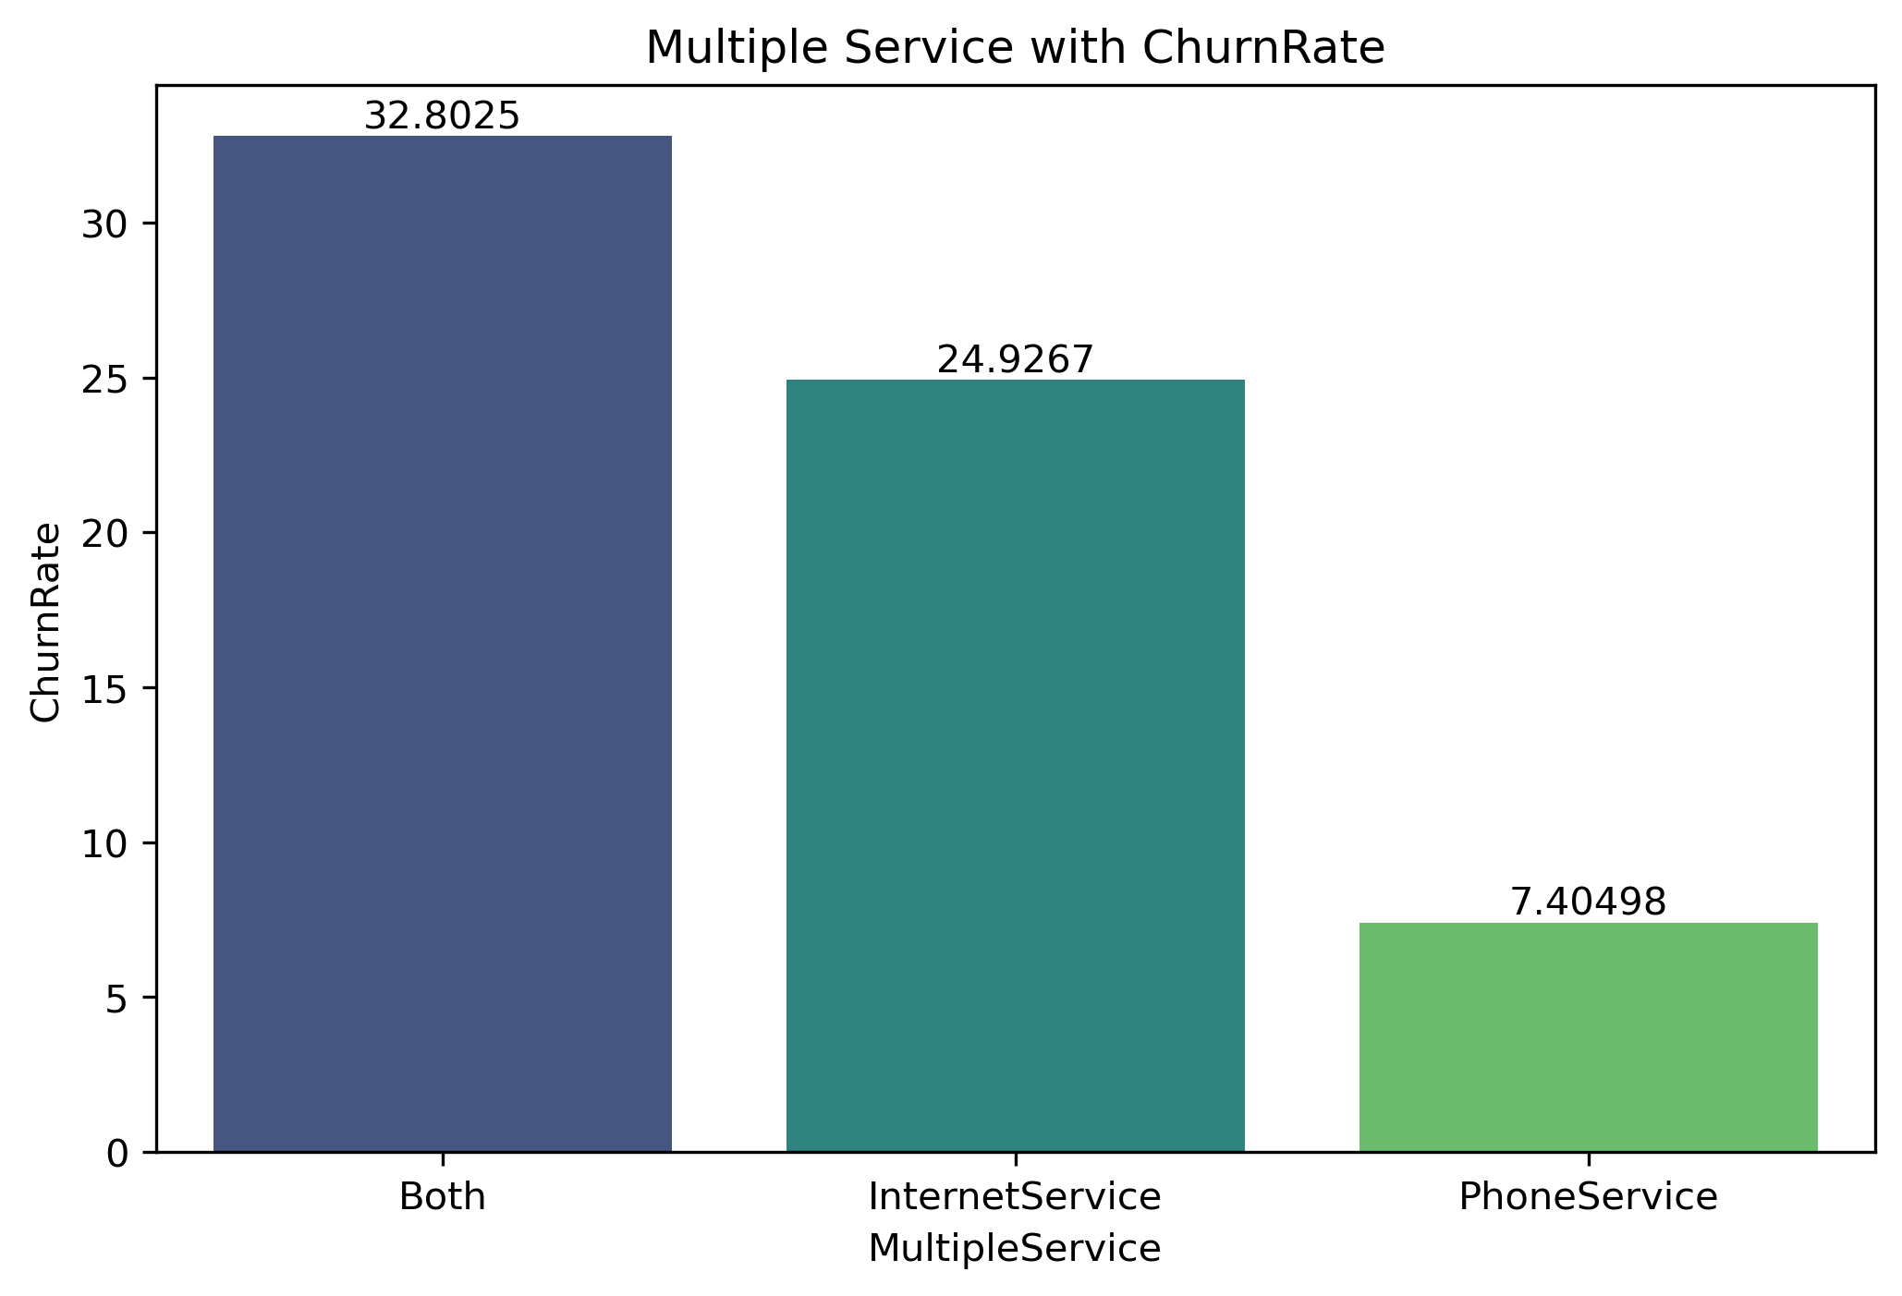
Internet only customers have the highest churn rate
Customers who use only Internet Service have the highest churn rate (24.9%), followed by those using both Internet and Phone services (32.80%%).
Customers with only Phone Service show the lowest churn rate (7.4%), suggesting that internet-related issues or dissatisfaction may be the key churn drivers.
Improve internet service reliability and address frequent connectivity or speed issues.
Enhance customer support for internet-related complaints.

